Slide 1
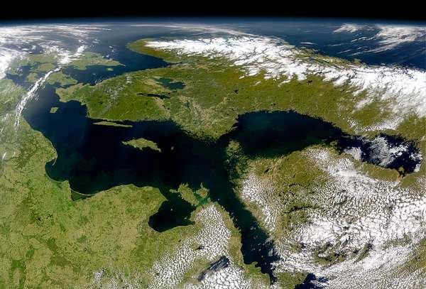
Sustainable tourism
in the context of
‘Grand Tour of Baltic Sea Region’
Vilnius, Lithuania 27-28 April 2016 Presentation by Cecilie Smith-Christensen
World Heritage Catalysis

Slide 2
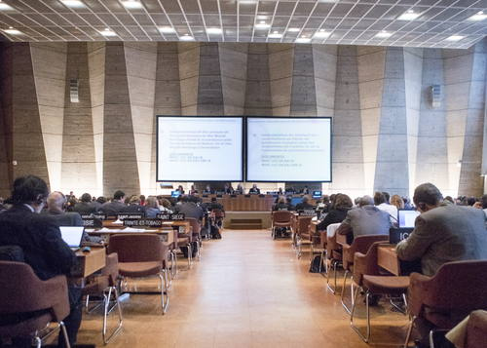
Policy on World Heritage and sustainable development
Policy for the integration of a sustainable development perspective into the process of the World Heritage Convention (WHC-15/20.GA/INF.13)
social responsibility
standard-setter for best practice
Encouraging locally driven responsible and sustainable tourism management!
Notes:
Enabling World Heritage stakeholders to act with social responsibility
Enhancing WH as a standard-setter for best practice

Slide 3
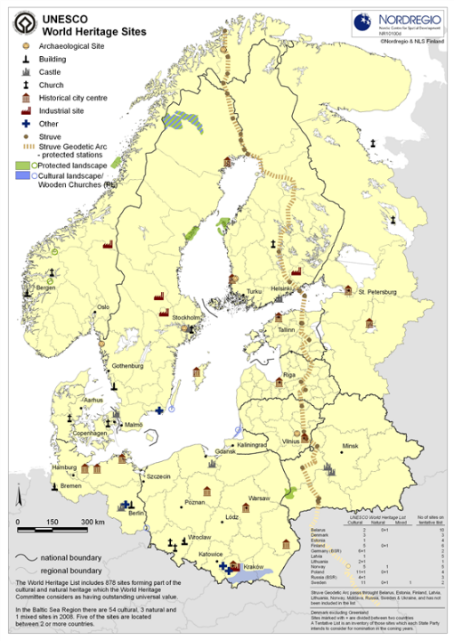
Project vision
‘to contribute to sustainable regional growth in the society surrounding each World Heritage site by using the force of the unique environment of the site as a resource for development.
Notes:
Vision of the project and base of all activities is

Slide 4
Sustainability in context of the project
The regional context - ‘Contribute to sustainable regional growth’
Swedish Institute priority areas
EU Strategy for Baltic Sea Region (EUSBSR)
The overall project and the project elements
‘The Route’ and ‘WH Laboratories’
Market mechanisms vs. funding.
The involved WH sites / destinations
Management of tourism and considerations for the OUV
Tourism contribution to local sustainable development
The TBL: the economy, society and environment
Notes:
- ‘Contribute to sustainable regional growth’
Shared priorities
Swedish Institute priority areas ‘Sustainable growth from increased prosperity’ and ‘An ecologically sustainable region’
EU Strategy for Baltic Sea Region (EUSBSR) and policy areas on education, culture, innovation, tourism etc.

Slide 5
Notes:
Helping site mangers pro-actively manage tourism within the context of the broader destination.

Slide 6
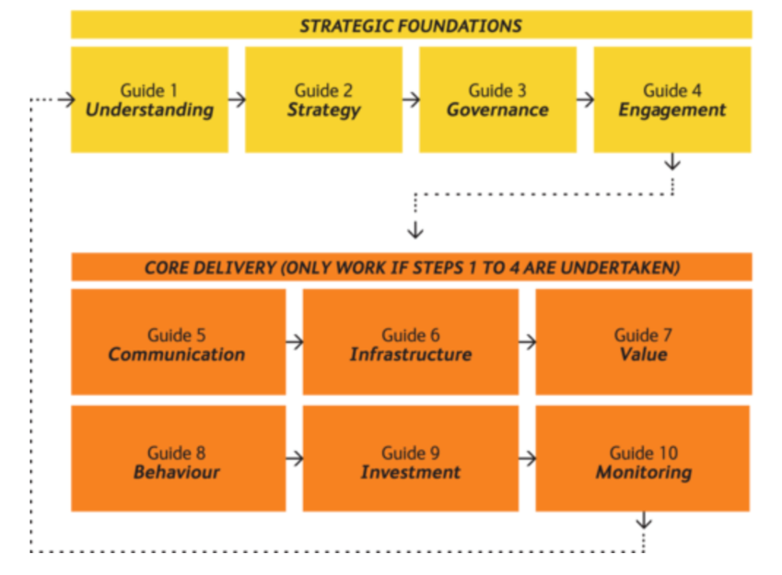
UNESCOs ‘How To’ Guides
Notes:
HTG 1-4 to establish basic foundation for strategy development.
HTG 5-10 tailored for more specific issues. Some topics more relevant than other.

Slide 7
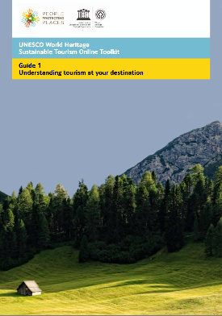
Why tourism matters, and information you need to start managing tourism.
Define terms of reference – the WH destination
Collect key tourism indicators, identify and fill gaps (possibly using other partners resources)
Create inventory of key data and make it accessible

Slide 8
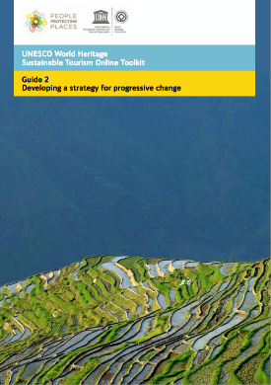
How to develop a strategy for your destination considering both the heritage values (OUV), as well as sustainable and proftiable tourism.
Identify key stakeholders
Identify critical issues affecting the WH site/destination
Get support to develop a destination strategy
Develop a multi-year sustainable tourism strategy
Identify implementing agency/ies (e.g. a DMO)
Publish and champion the strategy
Encourage feedback and reassess periodically

Slide 9
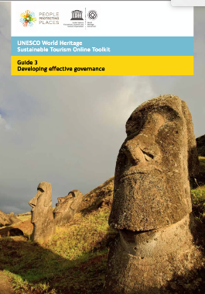
Why good destination management and governance matters, and how to start developing it in your World Heritage destination.
Destination management ≠ WH management
Use an existing DMO structure, create one or identify alternative management structure
Develop / enforce clear rules and regulations

Slide 10
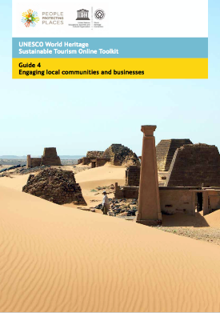
How to reach out and engage with local businesses and community in a dialogue explaining the mutual benefit of making tourism more sustainable.
Talk and listen to the host community incl. businesses
Identify and communicate local economic and sustainable opportunities
Encourage, celebrate and reward responsibility
Create a stakeholder forum

Slide 11
‘How To’ Guides 5-10

Slide 12
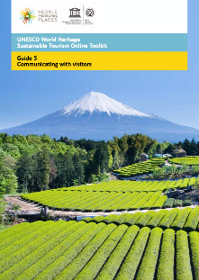
Why communicating with visitors matters, and how to do it effectively and in a culturally appropriate manner.
Have a clear script for the destination and key messages everyone will understand
Be creative in communicating
Communicate to build relationships with visitors
Outsource communication – guide training

Slide 13
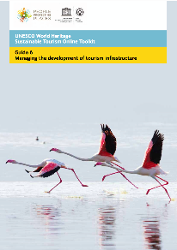
Why infrastructure is vital to sustainable tourism, and how to develop appropriate infrastructure.
Assess the capacity of infrastructure in the
WH destination
2. Plan ahead for needed infrastructure
Develop a spatial master plan with parameters for responsible growth
Ensure infrastructure does not negatively affect the OUV (EIA and HIAs)

Slide 14
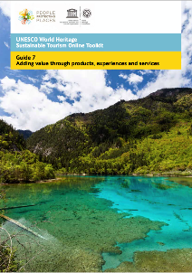
How to think about developing products, services, and experiences as a key way to sustain the OUV of the site, enthuse tourists, and benefit local communities.
Identify p/s/e that exists and that can be developed
Support entrepreneurs and locally based providers
Add value to products e.g. by branding
Consider “intellectual property” (IP)
Be creative in promoting and availing the p/s/e

Slide 15
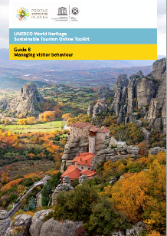
Why there is a need to manage visitor movements and behaviour, and how you may start to develop a visitor management system.
Analyse the situation – trends, seasonality and fluctuations
Develop carrying capacity plan and approach to how to manage visitors (access, pricing, ticketing, etc.)
Give people info to make good choices

Slide 16
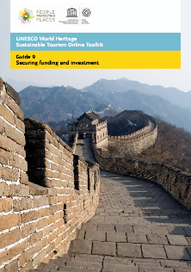
Ways to secure investment making your aspirations for the WH destination a reality.
Ways to finance World Heritage (taxation, raising commercial revenue, fundraising
Identify what needs funding and how much is needed
Identify funders and investors
Develop fundraising strategy and pitch (value)
Establish fundraising mechanisms
Build fundraising capacity

Slide 17
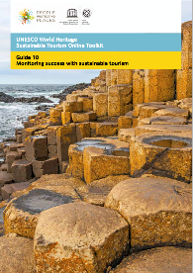
Why benchmarking matters and how to develop site and destination specific benchmarks.
Identify SMART benchmarks and milestones in the strategy (conservation of OUV, community, economy, environment)
Set timescales for monitoring and ensure benchmarks are keep relevant
Ensure transparency – both success and failure
Refresh / revise your strategy if necessary

Slide 18
Coming soon: WH Baseline Self-assessment Tool
enable site manager to assess to which degree tourism, within the context of the overall management plan, is managed sustainably
support the development and implementation of sustainable World Heritage tourism strategies
Notes:
The tool will be used by site managers to assess current achievement and progress towards a set of target indicators for sustainable World Heritage tourism management*.
Based on a destination profile including baseline indicators, the tool will help site management identify critical issues, and prioritise activities, actions and resources in the effort to optimise positive and minimise negative impacts from tourism on the World Heritage values (OUV) and the broader World Heritage destination.
The tool will point the user to the most relevant resources including 'How To' guides and best practice that may be specifically relevant in the further management efforts.
The tool will be used by site managers to assess current achievement and progress towards a set of target indicators for sustainable World Heritage tourism management*.
Based on a destination profile including baseline indicators, the tool will help site management identify critical issues, and prioritise activities, actions and resources in the effort to optimise positive and minimise negative impacts from tourism on the World Heritage values (OUV) and the broader World Heritage destination.
The tool will point the user to the most relevant resources including 'How To' guides and best practice that may be specifically relevant in the further management efforts.

Slide 19
The tourism management cycle
Critical issues / Baseline / Monitoring
('How To' Guides 1 & 10)
Develop / refine strategy
('How To' Guides 2-9)
Implement strategy

Slide 20
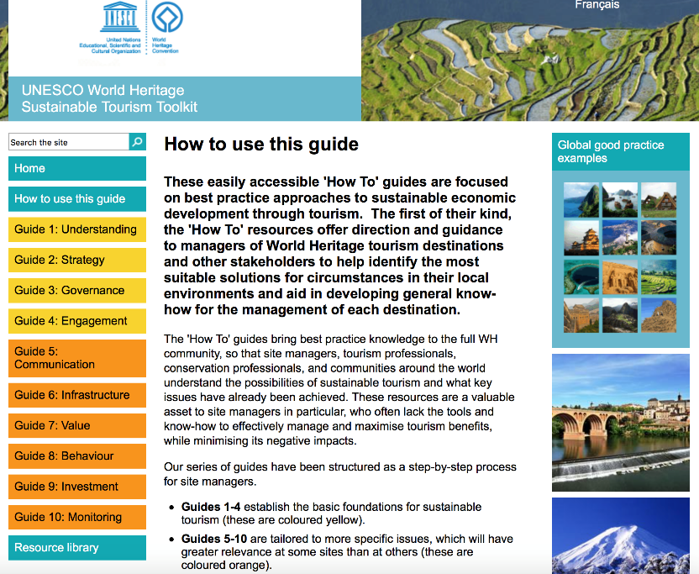
http://whc.unesco.org/sustainabletourismtoolkit/how-use-guide

Slide 21
Pinterest board on global good practice

Slide 23
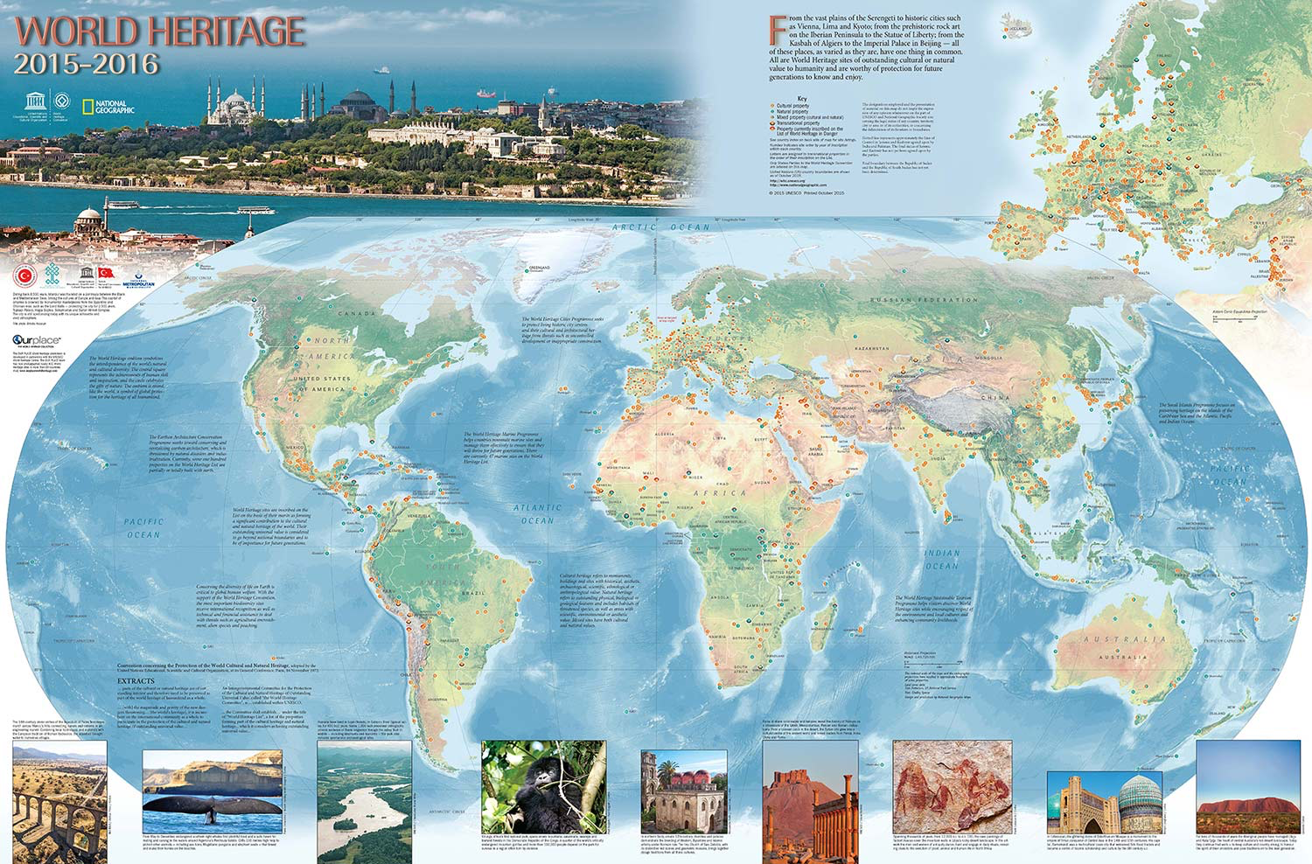
Efforts in other regions
Notes:
Mosi-oa-Tunya (Zambia/Zimbabwe)
(2) Maloti-Drakensburg Park (South Africa/Lesotho)
(3) Lake Malawi National Park (Malawi)
(4) Ngorongoro Conservation Area (Tanzania)

Slide 24
Process of developing strategies
I. Regional inception workshop
II. National workshops
Initiation workshop
- Vision and critical issues
Specialisation workshop
- Strategic objectives, action planning
Finalisation workshop
III. Regional conclusion workshop

Slide 25
Strategy elements
1 | Introduction | Background for developing the strategy. The destination defined.
2 | Vision | The shared vision for tourism at the World Heritage destination (a 10 years perspective)
3 | Key information and statistics | Tourism related information (status and forecasts)
4 | Heritage values (OUV) | Outstanding Universal Values of the World Heritage site and how heritage values are communicated.
5 | Critical issues / Baseline | The degree to which sustainable tourism is addressed prior to strategy development and implementation.
6 | Strategic objectives | The overarching goals of the strategy. Relating to critical management issues.
7 | Outcomes | The difference made. Tangible or intangible impacts/results from implementing the strategy.
8 | Prioritized actions | What to do. (Starting point for the Action Plan)

Slide 26
Strategy elements
9 | Stakeholders | Broad based identification of stakeholders, including issues and opportunities.
10 | Governance and policy measures | Destination management / DMO (existing vs. new)
11 | Partners | Partners in implementation. Role of tourism sector.
12 | Way forward | The development of a corresponding Action Plan and Budget (beyond the scope of project). How to integrate the strategy into a more extensive Tourism Master Plan.
13 | Statement of collective commitment
14 | Signatures
15 | Credits and contacts

Slide 27
Project vision
‘to contribute to sustainable regional growth in the society surrounding each World Heritage site by using the force of the unique environment of the site as a resource for development.
Notes:
Vision of the project and base of all activities is

Slide 28
Cecilie Smith-Christensen
Sustainable Tourism catalyst + World Heritage facilitator
World Heritage Catalysis
Email: csc@whcatalysis.com
Skype: cecilie.smith.christensen
Mobile: +47 976 99 468

