Slide 1
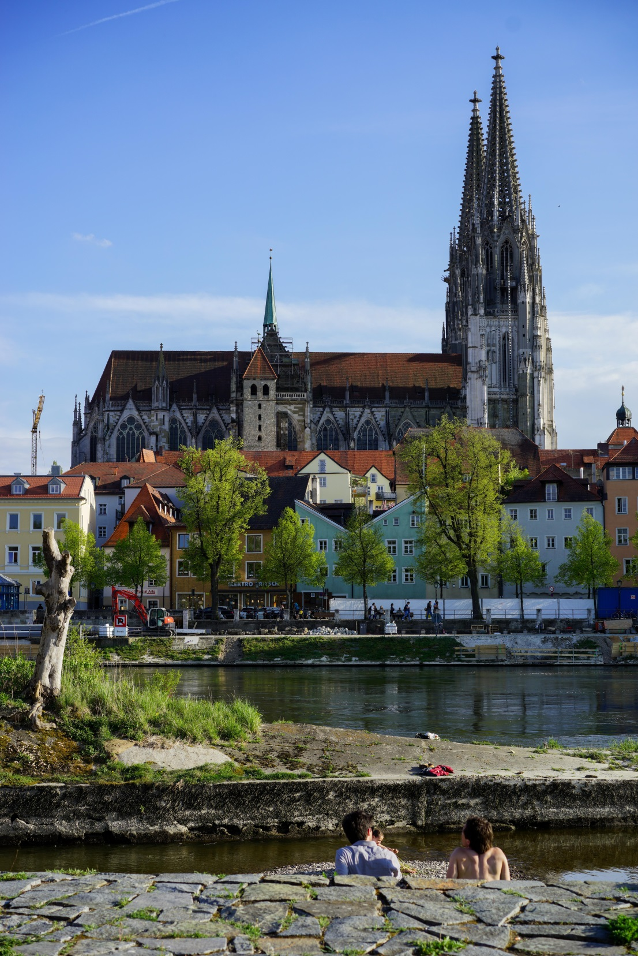
Organization of World Heritage Cities
Conference in Vilnius
April 27-28, 2016
Mr. Matthias Ripp
World Heritage Coordination
City of Regensburg
OWHC North-West Regional Secretariat

Slide 2
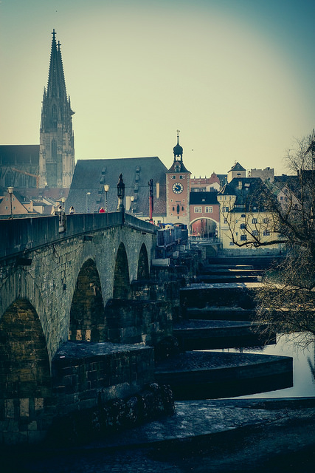
Overview
World Heritage Coordination Regensburg
OWHC North-West Regional Secretariat
Regional Conference 2016 in Stralsund/Germany

Slide 3
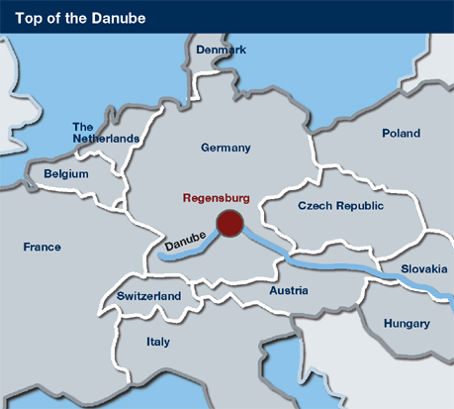
World Heritage Regensburg
„Altstadt Regensburg mit Stadtamhof“

Slide 4
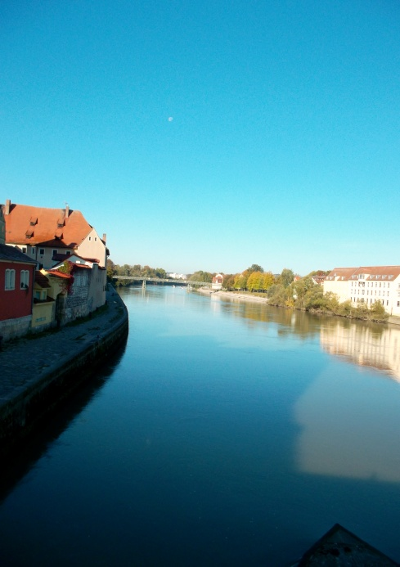
World Heritage Regensburg
The UNESCO Criteria
Criterion (ii) – Architecture and urban development
  Medieval trading center influencing the region north of the Alps.
Criterion (iii) – Testimony of a Culture
Exceptional testimony to the cultural traditions in the Holy Roman Empire.
Criterion (iv) – Explaining history
Outstanding example of a central-European medieval trading town with different stages of development still visible.

Slide 5
World Heritage Regensburg
World Heritage Coordination
A Coordination and Contact Point
B Monitoring
C Public Relations & raising awareness
D Networking & scientific activities

Slide 6
World Heritage Regensburg
World Heritage Coordination
Cooperation
Visitor Centre WH
Audio guide producer
Heritage-App
Programs in Museums
Universities/Schools
Stakeholders
Tourism Organization
Events
World Heritage Day
Exhibitions in Visitor Centre
Conferences
Lectures
Guided Tours through Visitor Centre
Publications
Information brochure
Special Interest (House owners / senior citizens)
website
books
Annual report
Articles for scientific revues

Slide 7
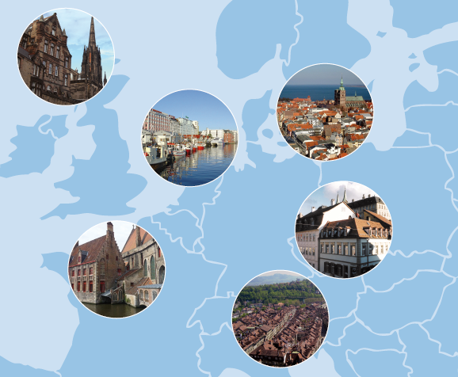
OWHC Regional Secretariat North-West Europe
MEMBER CITIES
Bamberg, Germany
Bath, United Kingdom
Beemster, Netherlands
Bergen. Norway
Berlin, Germany
Bern, Switzerland
Bremen, Germany
Brugge, Belgium
Cesky Krumlov, CR
Edinburgh, United Kingdom
Goslar, Germany
Karlskrona, Sweden
Liverpool, United Kingdom
Lübeck, Germany
Luxembourg, Luxembourg
Potsdam, Germany
Quedlinburg, Germany
Rauma, Finland
Regensburg, Germany
Røros, Norway
Stralsund, Germany
Vienna, Austria
Visby, Sweden
Weimar, Germany
Wismar, Germany
Warsaw, Poland
REGENSBURG
New:
Salzburg, Austria
Philadelphia, USA

Slide 8
OWHC Regional Secretariat North-West Europe
Since December 2011, the Regional Secretariat Northwest Europe is managed by the City of Regensburg
Objectives
Ambitious policy of development
Working programme based on integrated actions
To increase the communication
To strengthen the secretariat‘s role at a regional level
Growing membership

Slide 9
OWHC Regional Secretariat North-West Europe
Communication initiative
Brochure, Exhibition, Photo competition, video production
Strategic initiative
Strategic Initiative
Solidarity initiative
City2city Visits
Expertise initiative
Regional conferences and meetings

Slide 10
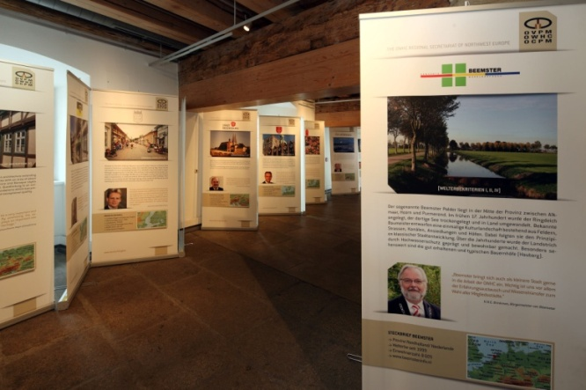

OWHC Regional Secretariat North-West Europe
COMMUNICATION INITIATIVE
Exhibition
strengthens relationships between the World Heritage Cities members of the Regional Secretariat;
communicates about the OWHC to a wide public
© Peter Ferstl
Brochure
brief summary of the exhibition in a smaller and easier-to-disseminate format

Slide 11
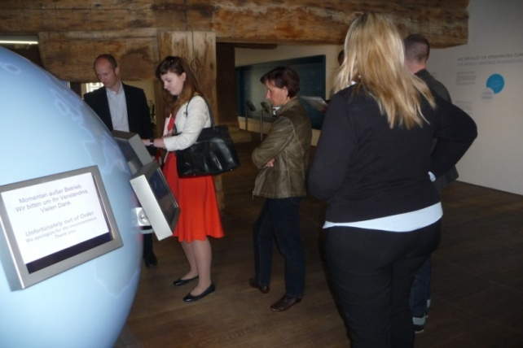
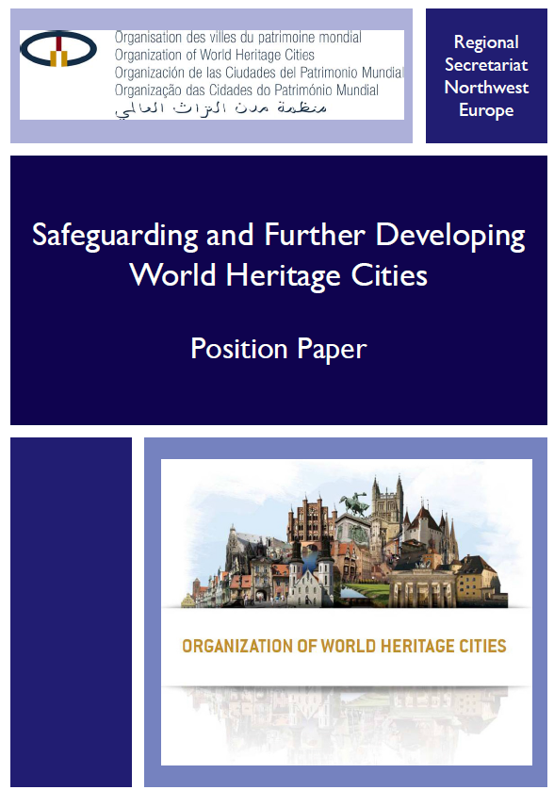
OWHC Regional Secretariat North-West Europe
SOLIDARITY INITIATIVE
STRATEGIC INITIATIVE
aims to strengthen the position of the Regional Secretariat Northwest Europe within the OWHC network
© Municipality of Regensburg
The paper refers to the World Heritage and its management. A broader version with a European point of view is in progress and will be published within the Regional Secretariat.
Increase in exchange of experience between the member cities
City to city visits
The City of Regensburg organized three city-to-city visits in 2012, with Vienna, Wismar and Český Krumlov. Such issues as management structures, the use of historic buildings, design regulations, the role of the visitor center were analyzed and discussed

Slide 12
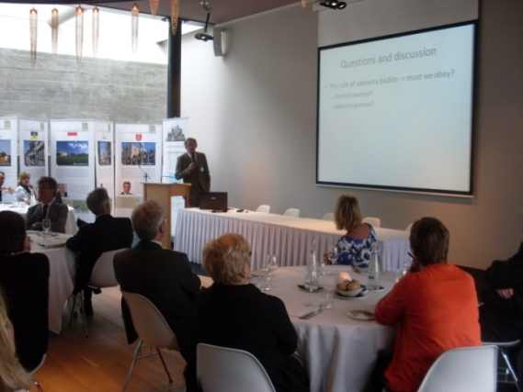
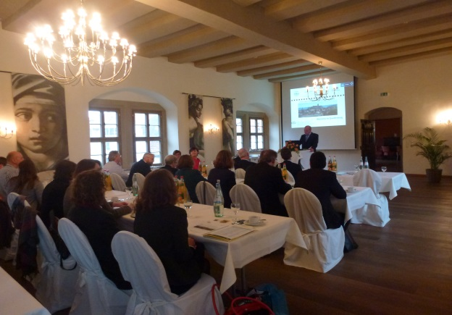
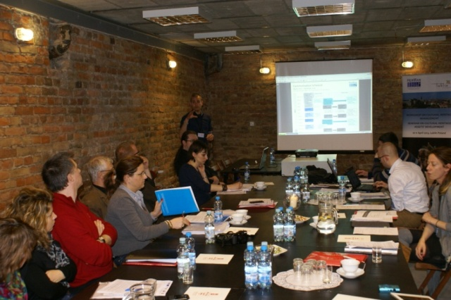
OWHC Regional Secretariat North-West Europe
EXPERTISE INITIATIVE
© Municipality of Regensburg
© Municipality of Lublin
© Municipality of Beemster
Regional Conference, September 2012, Beemster (Netherlands)
Regional Meeting, November 2013, Regensburg
HerMan Project Conference, April 2013, Lublin (Poland)
exchange of expertise on the management plan principles
identification of the historic urban landscapes
Crisis as Opportunity for World Heritage Cities – Resilience
the activities of the OWHC and the Regional Secretariat were presented during a conference within the EU HerMan Project

Slide 13
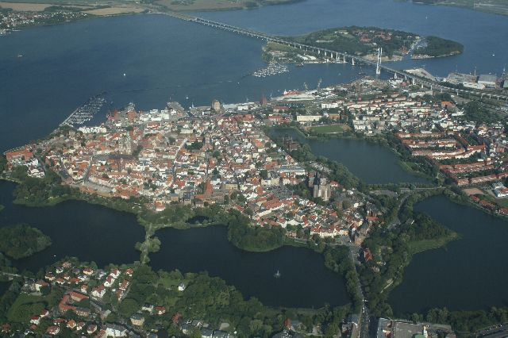
OWHC North-West Europe Regional Meeting
September 27-29, 2016 in Stralsund/Germany
Welcome to the Hanseatic Town of Stralsund!
Historic cities Stralsund and Wismar (World Heritage since 2002)
Population: 57.540 inhabitants
A town made from brick, A town of museums, A town by the sea
A town close to nature

Slide 14
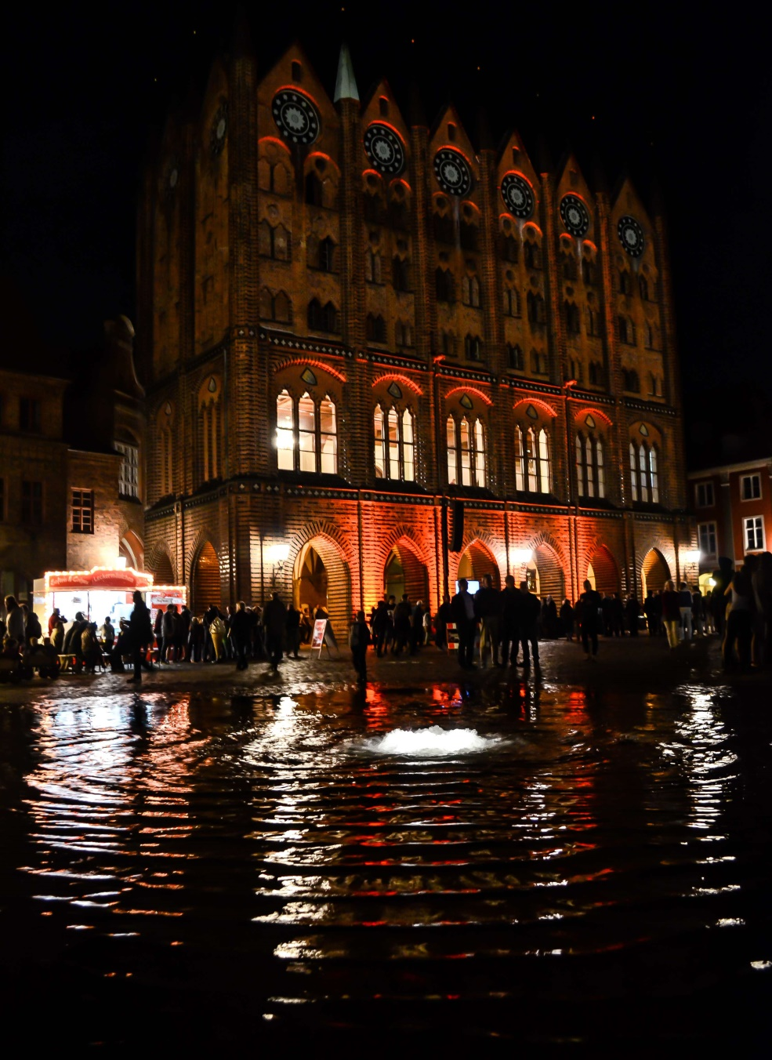
OWHC North-West Europe Regional Meeting
September 27-29, 2016 in Stralsund/Germany
Topic
„Heritage & Community Involvement“

Slide 15
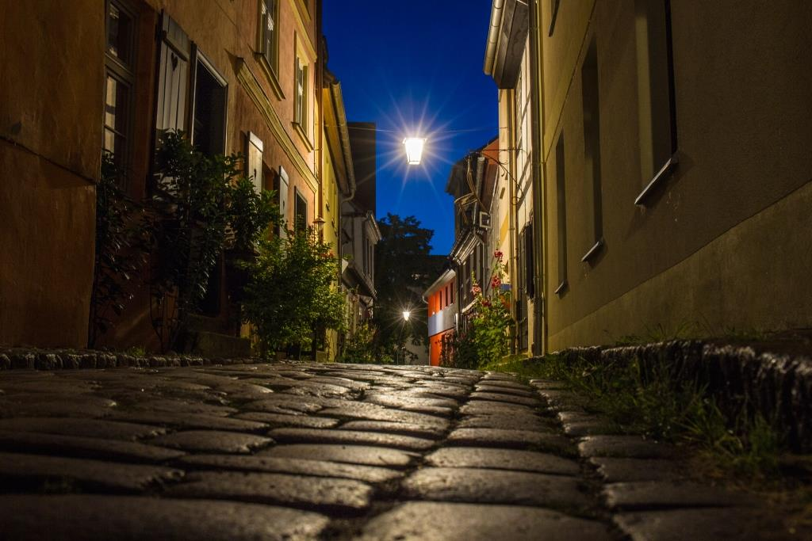
OWHC North-West Regional Meeting
September 27-29, 2016 in Stralsund/Germany
Key note speech, Workshops, meeting for members in good standing, Podium for member cities
Target groups are member cities, politicans, mayors, all professionals
and experts and interested cities in World Heritage.
For more detailed information about conferences of the OWHC North-West
Region, please take a look at the Final Report of the last conference
held in Quedlinburg in 2015 with the topic „Crisis as Opportunity for
World Heritage Cities – Resilience“
Badstüberstraße, Stralsund

Slide 16
OWHC Regional Secretariat North-West Europe
Imagefilm 2015

Slide 17
Thank you for your attention

