Slide 1
The story is everything

Slide 2
We are living in the best of times!

Slide 3
We are living in the best of times!
Since September 2008
Financial crisis
Greece crisis
Ukraine crisis
Russian crisis
Crisis in Syria
Natural disasters and disease outbreaks

Slide 4
We are living in the best of times!
Since September 2008
Financial crisis
Greece crisis
Ukraine crisis
Russian crisis
Crisis in Syria
Natural disasters and disease outbreaks
Since 2008, Nordic airports + 10 000 new international passengers every day! Each!

Slide 5
We are living in the best of times!
Since September 2008
Financial crisis
Greece crisis
Ukraine crisis
Russian crisis
Crisis in Syria
Natural disasters and
Since 2008, Nordic airports + 10 000 new international passengers every day!
We are constantly on the move

Slide 6
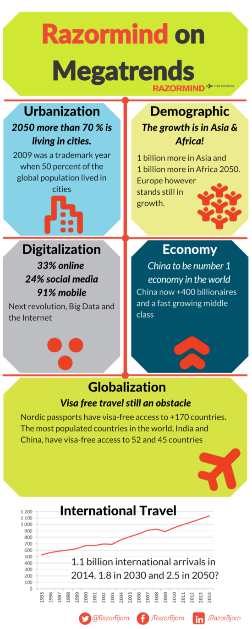
The “Mega-Trends” rules the world
We are living in the best of times
Strong middleclass
Richer, healthier and more time for developing own interests
Economy
Demographic
Digitalization
Globalization
Urbanization
Notes:
…….yes it can. Most likely, we are just in the middle of a long era with increasing global activity and the UNWTO are forecasting 1.8 billion arrivals by 2030. When we are looking back to these last decades of 20th century and first decades of 21st century, we will recognize this years as the time when global travel were exploded.

Slide 7
The “Mega-Trends” rules the world
Economy
Demographic
Growth in numbers and in age!
More active in high age
Digitalization
Globalization
Urbanization
Notes:
…….yes it can. Most likely, we are just in the middle of a long era with increasing global activity and the UNWTO are forecasting 1.8 billion arrivals by 2030. When we are looking back to these last decades of 20th century and first decades of 21st century, we will recognize this years as the time when global travel were exploded.

Slide 8
The “Mega-Trends” rules the world
Economy
Travel industry biggest benefiter from IT-revolution
Smart phones and tablets dominating
“If you are not in my phone you don’t exist”
OTA are controlling all distribution
Demographic
Digitalization
Globalization
Urbanization
Notes:
…….yes it can. Most likely, we are just in the middle of a long era with increasing global activity and the UNWTO are forecasting 1.8 billion arrivals by 2030. When we are looking back to these last decades of 20th century and first decades of 21st century, we will recognize this years as the time when global travel were exploded.

Slide 9
The “Mega-Trends” rules the world
Economy
Demographic
Digitalization
International relations growing
Less Visa restrictions
Globalization
Urbanization
Notes:
…….yes it can. Most likely, we are just in the middle of a long era with increasing global activity and the UNWTO are forecasting 1.8 billion arrivals by 2030. When we are looking back to these last decades of 20th century and first decades of 21st century, we will recognize this years as the time when global travel were exploded.

Slide 10
The “Mega-Trends” rules the world
Economy
Demographic
Digitalization
Globalization
Extreme urban world
Tourism growing faster in cities
Urban nature and wild life travel strong trends
Urbanization
Notes:
…….yes it can. Most likely, we are just in the middle of a long era with increasing global activity and the UNWTO are forecasting 1.8 billion arrivals by 2030. When we are looking back to these last decades of 20th century and first decades of 21st century, we will recognize this years as the time when global travel were exploded.

Slide 11
Hospitality Industry – the World’s Largest Service Industry
International travellers (UNWTO)
1950: 25 million international arrivals
2015: 1.2 billion international arrivals
2030: Forecasted to 1.8 billion international arrivals
Travel tourism impact
2.4 trillion USD in revenue
9.8 percent of world GDP
Directly employs 105 million
Created 6.1 million new jobs (direct)
Indirectly employs 277 million (1/11)

Slide 12
No more mainstream travel
Everything is growing – Luxury and budget
The revival of first class travel, Ultra luxury Hotels
Hostels – Upgraded and “hip”
Urban Nature and wild life adventures
Personal style travel – same trend personal style fashion
1.8 billion international arrivals in 2030 is 1.8 billion reasons for travel

Slide 13
Market Trends – Demographic generated
Millennials (today 25-35 years) will be 75% of the global workforce 2030. Today they are gamers!
The Global traveler – multi-diverse when it comes to, lifestyles, religion, ethnicities, interests and education
The female traveler:
One of the largest emerging markets/segments in the world
Influencing 85 percent of all purchasing decisions within a family (US)
Accounts for 58 percent of all online sales (US)
Wellness travel/tourism:
Health awareness lifestyle – growing trend
(12 percent annual growth since 2012) USD 500 billion market

Slide 14
Travel Trends – Airbnb and OTA
Airbnb Largest distribution channel in the world – it’s here to stay!
34,000 cities, 190 countries except…
...Syria, North Korea and Iran
Airbnb supply growth:
2008 – a few thousand listings
2015 – 1.5 million listings
Airbnb providing a new sales force to your city!
Online Travel Agencies - still gaining market shares
Approximately 95 percent of the market is controlled by Priceline and Expedia
Tripadvisor and Google – next OTAs?

Slide 15
The story is everything
Airbnb and OTA are selling the rooms……
Airbnb and OTA are moving in to packaging…….
The costumer knows more than you……
…….But you have the story

Slide 16
Svanstein story

Slide 17
Svanstein story
N
Svanstein
Finland
Sweden
S

Slide 18
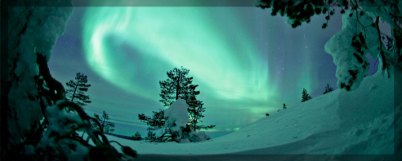
Svanstein story
Border crossing
First stop after Arctic Circle crossing
Torne River is the actual border dividing Swedish and Finnish Lapland
N
Svanstein
Arctic Circle
Finland
Sweden
S

Slide 19
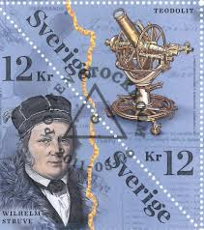
Svanstein story
Border crossing
First stop after Arctic Circle crossing
Torne River is the actual border dividing Swedish and Finnish Lapland
Struve Geodetic Arc is crossing 10 countries and on the top of Pullinki mountain marks one of the locations
N
Svanstein
Arctic Circle
Struve Geodetic Arc
Consists of 265 points in ten countries. The measurements were made between 1816 and 1855 under the supervision of the German-born astronomer Wilhelm Struve (1793–1864) with the purpose of determining the shape of the earth. 34 of the 265 points are since July 2005 included on the UNESCO World Heritage List. Four of these 34
points are located in the Swedish part of the
Torne Valley..
Struve Geodetic Arc
Finland
Sweden
S

Slide 20
Svanstein story
Border crossing
First stop after Arctic Circle crossing
Torne River is the actual border dividing Swedish and Finnish Lapland
Struve Geodetic Arc is crossing 10 countries and on the top of Pullinki mountain marks one of the locations
N
Svanstein
Arctic Circle
Struve Geodetic Arc
Consists of 265 points in ten countries. The measurements were made between 1816 and 1855 under the supervision of the German-born astronomer Wilhelm Struve (1793–1864) with the purpose of determining the shape of the earth. 34 of the 265 points are since July 2005 included on the UNESCO World Heritage List. Four of these 34
points are located in the Swedish part of the
Torne Valley..
1753
Abraham Steinholz
Sara Svanberg
Struve Geodetic Arc
Finland
Sweden
S

Slide 21
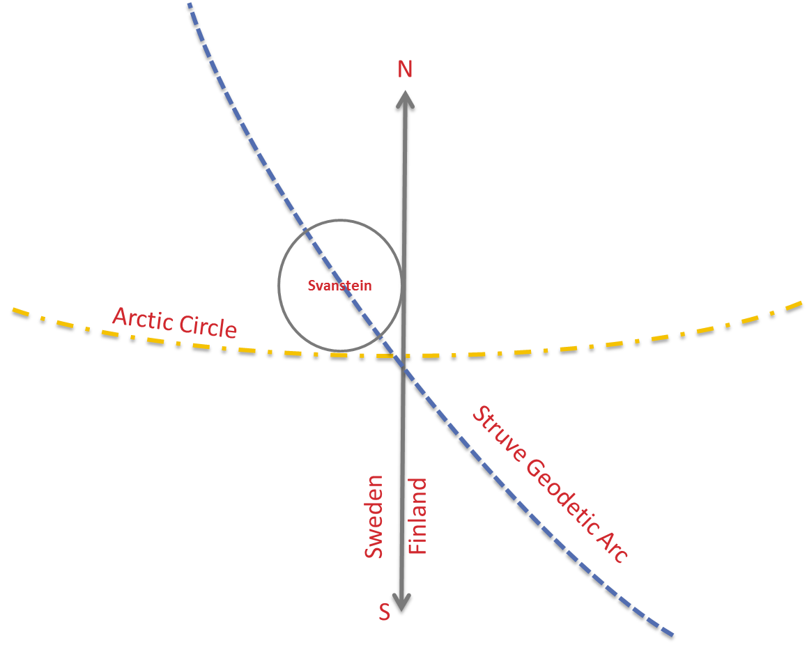
Svanstein Resort
120 room concept hotel
150 lots for sale
Restaurants, shops, activities
Design, colors, food, feelings
All year focus on summer but primary a winter sports area
“The Story is Everything”

Slide 22
The story is everything
I´m richer, older, global, digital and living in a city
My interests are in the phone next to the apps from Airbnb/OTA
And I love a good story!

Slide 23
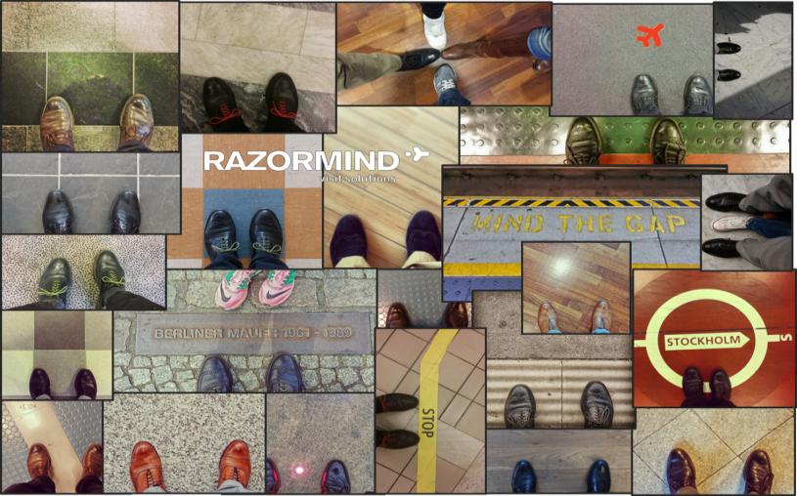
We bring facts to life
@Razorbjorn
@Razorbjorn
/razorbjorn
/Razorbjorn

Slide 24
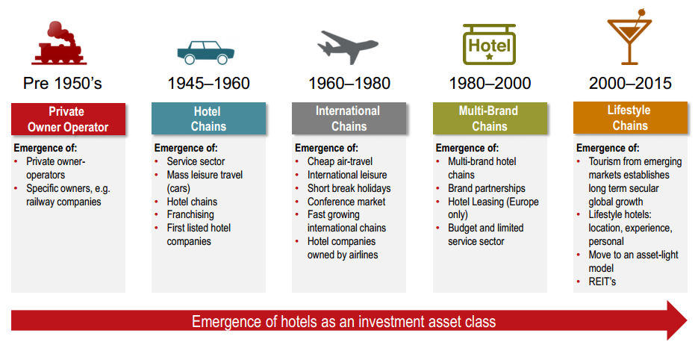
Evolution of the Hotels Business
Timeline: From an owner-operator model to a multi-brand, asset-light model

Slide 25
Rese- och turistnärings utveckling
Starkt driven av investeringar

Slide 26
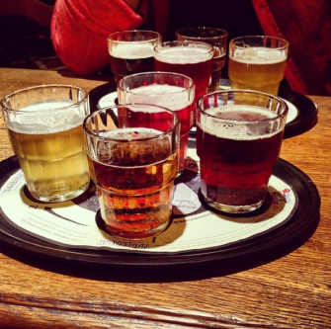
Rese- och turistnärings utveckling
Starkt driven av investeringar
Fragmenterad, specialintressen

Slide 27
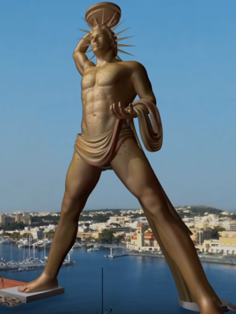
Rese- och turistnärings utveckling
Starkt driven av investeringar
Fragmenterad, specialintressen
Invest in your story

Slide 28
Rese- och turistnärings utveckling
Starkt driven av investeringar
Fragmenterad, specialintressen
Invest in your story
National Hotel, Miami Beach

Slide 29
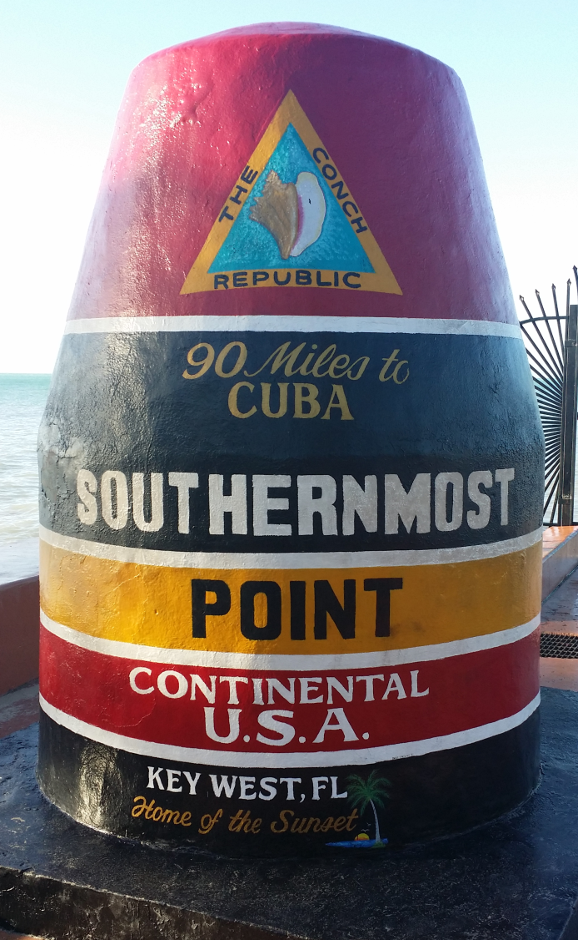
Rese- och turistnärings utveckling
Starkt driven av investeringar
Fragmenterad, specialintressen
Invest in your story

Slide 30
Market Trends – Hotel Concepts
New players entering the hotel market
With new dynamic concepts which attracts investments
Today more than 1,000 hotel companies with 5 hotels or more
White label brands such as Autograph collection by Marriott, Luxury Collection by Hilton & Quorvos by Rezidor
Hybrid Hotels – talking to the premium and hostel guest with one voice
Ultra luxury – talking to the leisure traveler
Change of order: budget hotels are trendsetters – self service check in, wifi, informal service – inspires premium hotels
TIME is now SERVICE – guests chose when they want service
F&B concepts that differentiates itself from the hotel

Slide 31
Market Trends – Distribution and OTAs
Online Travel Agencies - still gaining market shares
Approximately 95 percent of the market is controlled by Priceline and Expedia
Tripadvisor and Google – next OTAs?
OTAs help owners stay independent from major hotel brands…
…but you need specialist knowledge
Better late than never, hotel companies have woken up and now invest in IT/distribution systems
OTAs are IT companies, but compete with hospitality companies
The hotel industry needs to combine…
…IT knowledge and hotel knowledge to regain lost market shares

