Slide 1
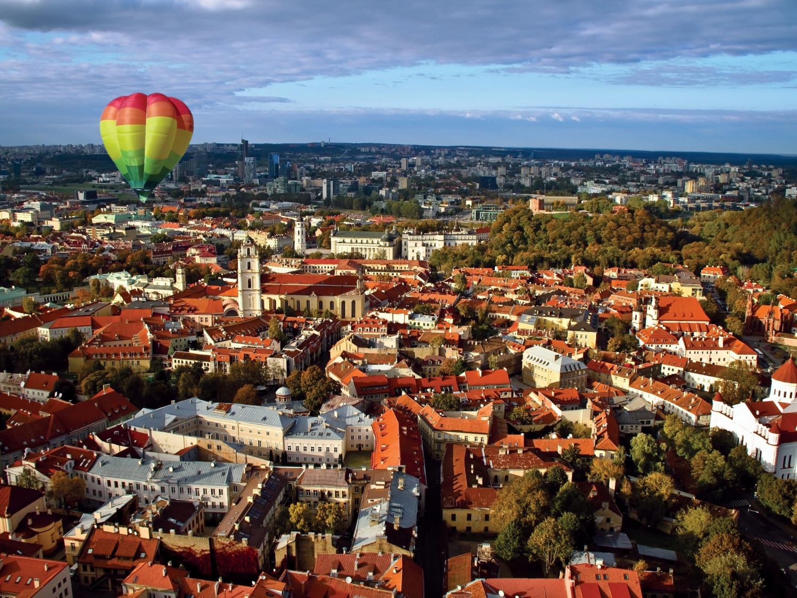
VILNIUS, LITHUANIA
Facts and figures: inhabitants - 543 000, day residences – 750 000; area – 401 sq.km; multicultural city – Lithuanians, Polish, Russians, Belarussians; one of the youngest capitals in EU (by age);
Vilnius Old Town - 365 ha; UNESCO site since 1994;
Strengths and opportunities: increasing awareness of CH as the strongest platform for city branding and truism growth; EU ERDF and SF investments in renovation of public spaces and infrastructure; visual monitoring of new developments’ impact on protected CH; successfully growing clusters of creative industries (gaming, apps design);
Needs and challenges: need for effective follow-up monitoring and improvement evaluation; gap in social structure of inhabitants in old town; number of brownfields to be developed; intense traffic and high number of personal cars; lack of sustainably managed public spaces.

Slide 2
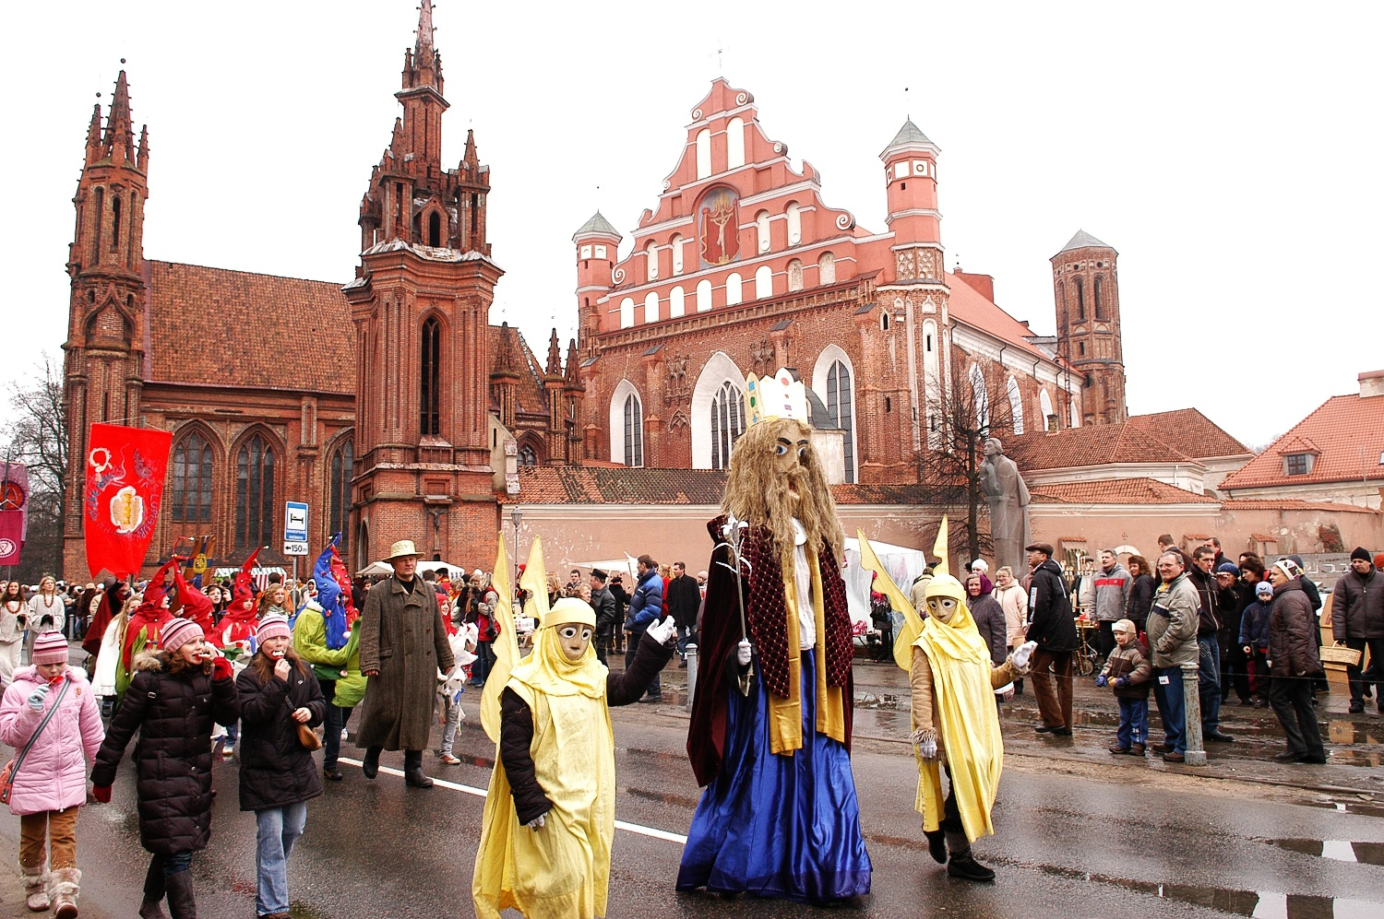
Cultural-scapes and creative urban environments
CH oriented events, supported by Fine Arts, Ethnographical Trades and Fairs (Traditional Crafts) Programme: 17 workshops-galleries supported by Municipality, organization of traditional fairs, crafts demonstrations;
Educational activities promoting CH identity - lectures, thematic tours, exhibitions;
Contemporary cultural events, promoting CH on the modern basis and branding the city on the international level;
Increasing number of creative urban areas for the innovative social interactions - art incubators, pop-up cultural activities;
Digital CH preservation-3D model of the city for examination of new constructions’ impact on panoramic views, new digital technologies for cultural heritage museums and cultural events.

Slide 3
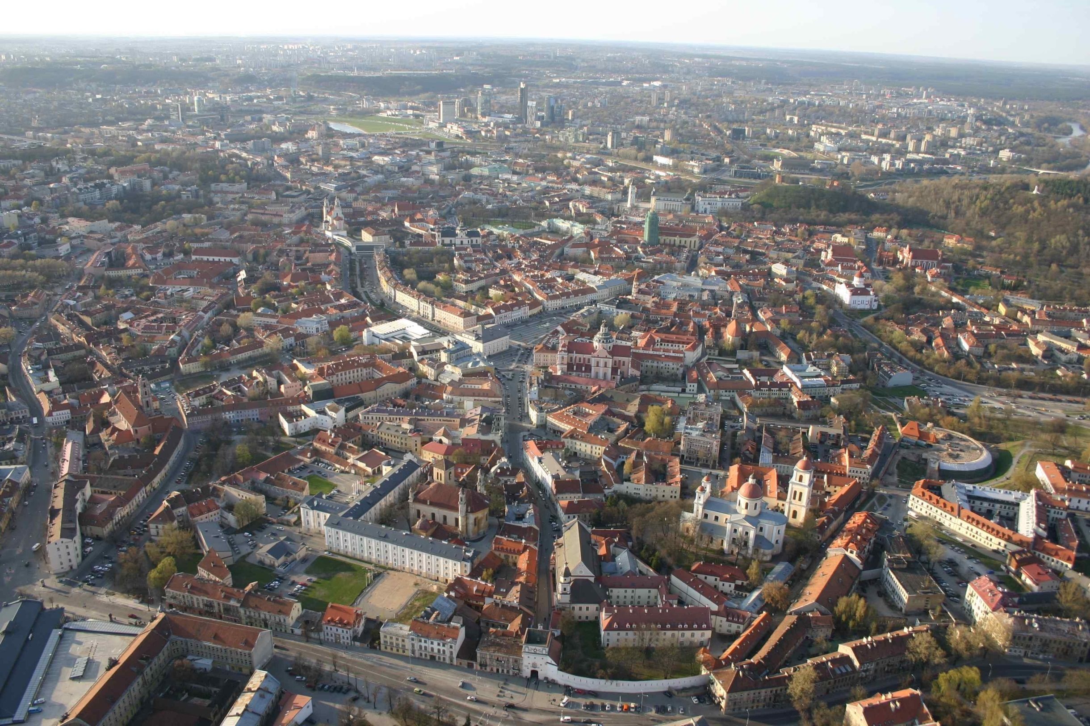
Monitoring and management tools
EXISTING:
Monitoring of protected immovable cultural heritage properties and valuable attributes of Vilnius Old Town: buildings, street views, panoramic views: photo fixations, acts of examination, documents of the former status digitalised.
Monitoring is implemented according to the UNESCO requirements. Monitoring data base is open for public;
Monitoring and evaluation system of impact of EU financed infrastructural renovations;
INNOVATIONS TO BE IMPLEMENTED:
Opinion Analytics ;
Video Neuroanalytics;
Result - Integrated Cultural Heritage Analytics (Multiple Criteria Cultural Heritage Analysis and Recommender System, Healthy Built Environment Multiple Criteria Analysis and Recommender System, Effective Regeneration and Adaptive Reuse Decision Support System, etc.).

Slide 4
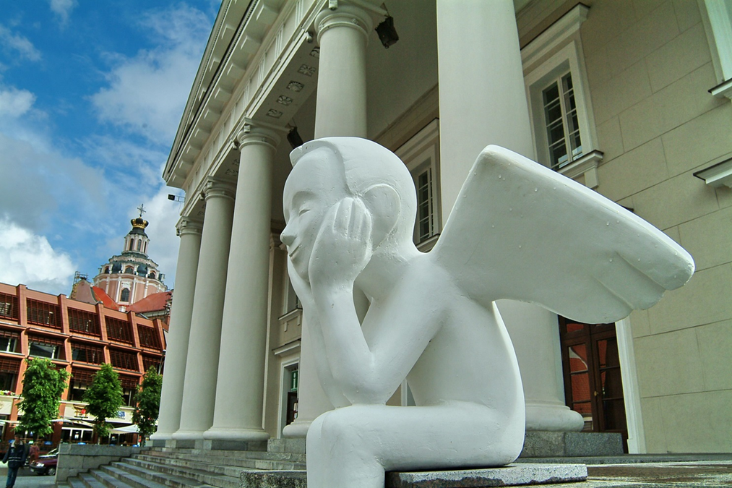
Heritage Governance
Management structure:
State level - Ministry of Culture,
State level - Department of Cultural Heritage;
Municipal level - Division of Cultural Heritage Protection;
Municipal level - Vilnius Old Town Renewal Agency (UNESCO site manager).
5 key stakeholders:
Association of Real Estate Development;
Vilnius Fine Crafts Association;
Go Vilnius – municipal investment and tourism promotion agency;
Cultural Heritage Department;
Local community of the Old Town.

Slide 5
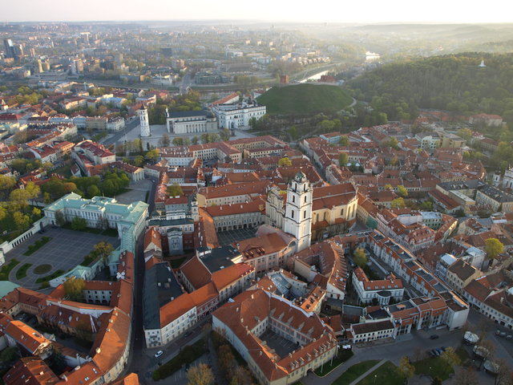
INITIATIVE TO BE IMPLEMENTED
Technical partner – VILNIUS GEDIMINAS TECHNICAL UNIVERSITY
Unique Video Neurolytics analysis method, to be carried out in the strategically important public places of UNESCO site;
Results evaluation and further actions plan creation on the level of the city management;
Initiative, which works in the Role model city ( and tested by selected tools) could be succesfully transferred to the Replicator cities.

Slide 6
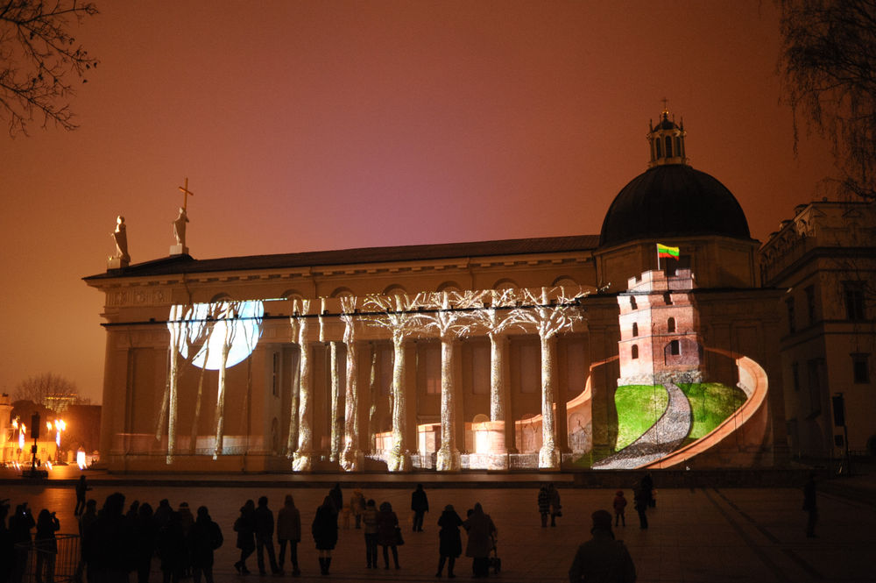
THANK YOU
ruta.matoniene@vilnius.lt

